Slide 1
In-class Exercise 17 - Active Contour Model
Dhiren Gupta
-800902466

Slide 2

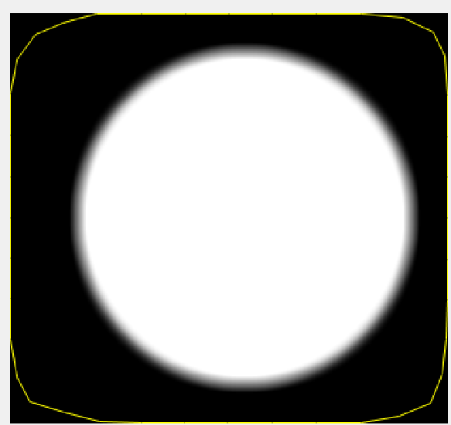
Iteration 1K: Input Image vs rendering of active contour

Slide 3
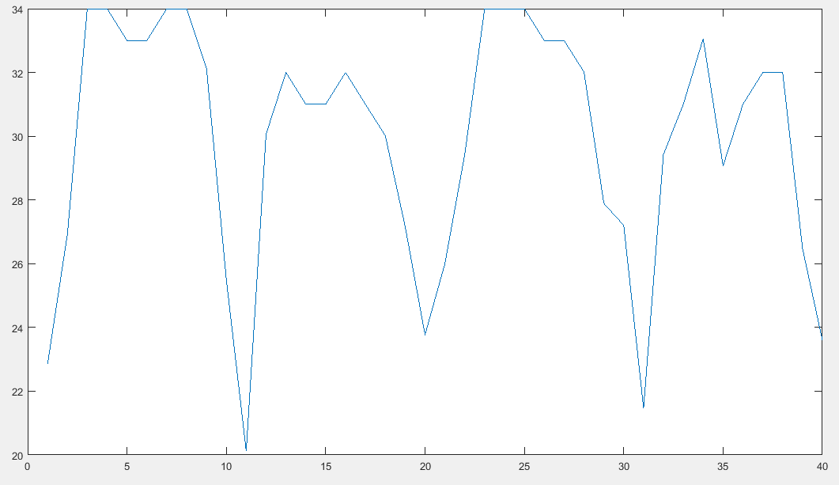
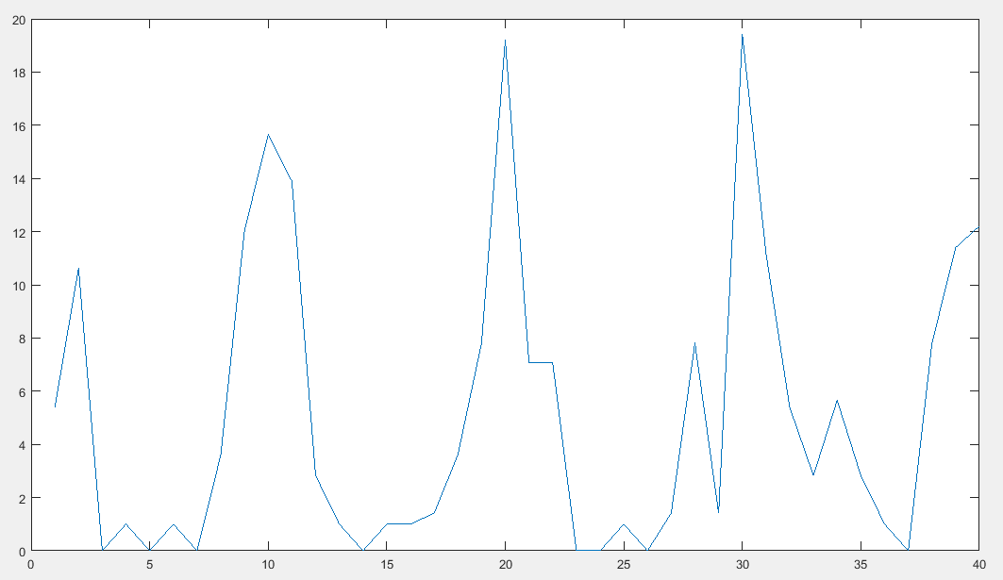
Iteration 1K: Internal energy
First Derivative
Second Derivative

Slide 4
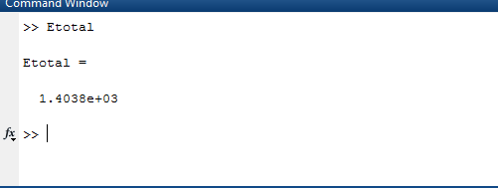
Iteration 1K:Total Energy & External Energy
Total Energy
External Energy : 0

Slide 5
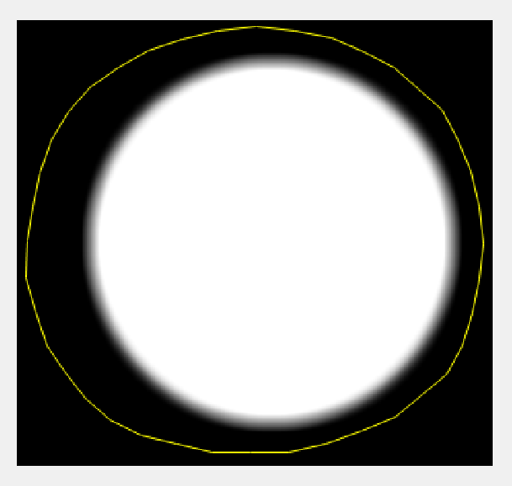
Iteration 30K: Input Image vs rendering of active contour

Slide 6
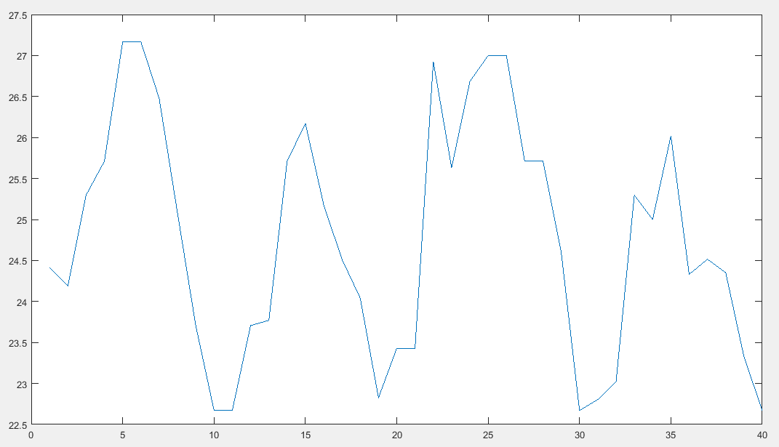
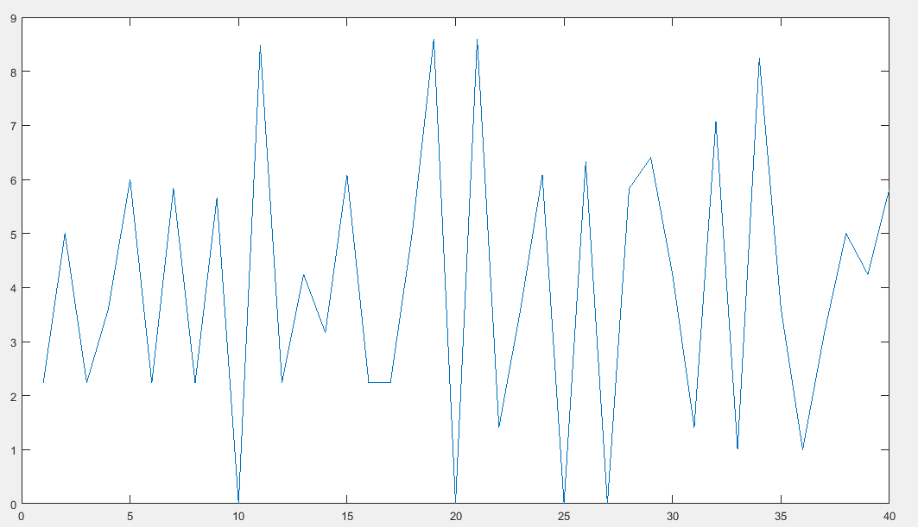
Iteration 30K: Internal energy
First Derivative
Second Derivative

Slide 7
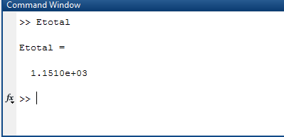
Iteration 30K:Total & External Energy
Total Energy
External Energy :0

Slide 8
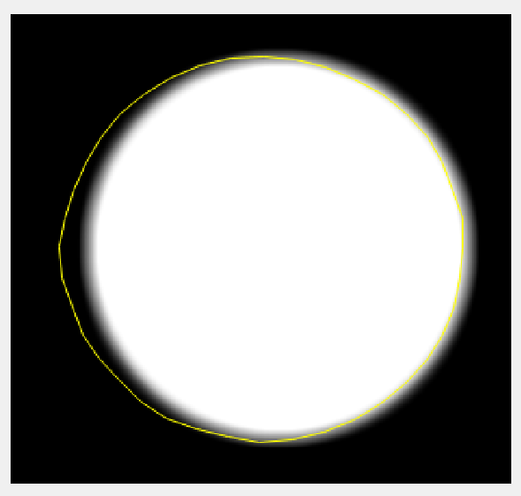
Iteration 100K: Input Image vs rendering of active contour

Slide 9
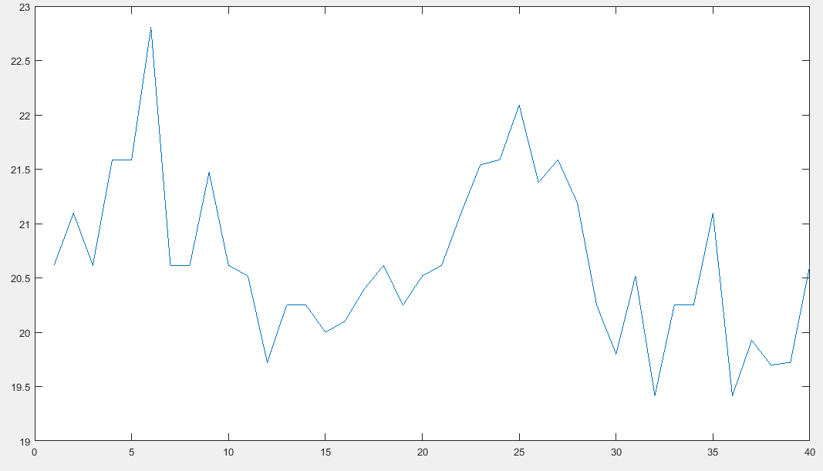
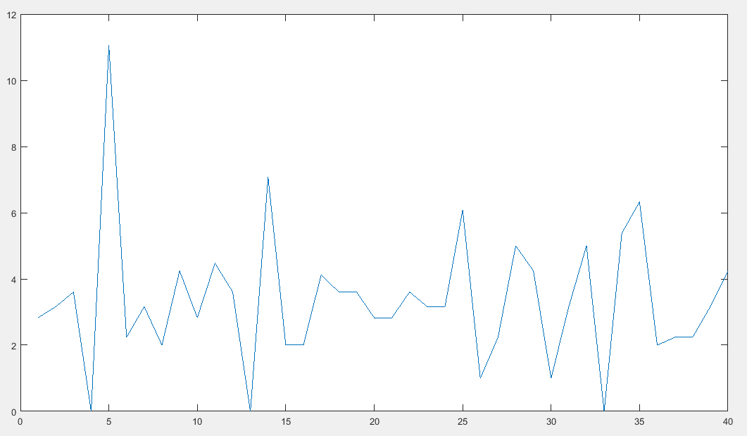
Iteration 100K: Internal energy
First Derivative
Second Derivative

Slide 10
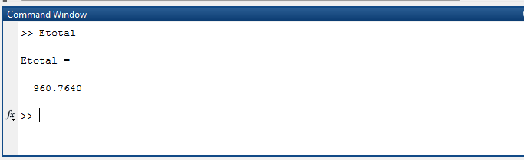
Iteration 100K:Total & External Energy
Total Energy :
External Energy :0

Slide 11
Thank You

